Slide 1
Line Ups
DP Flex Edition

Slide 2
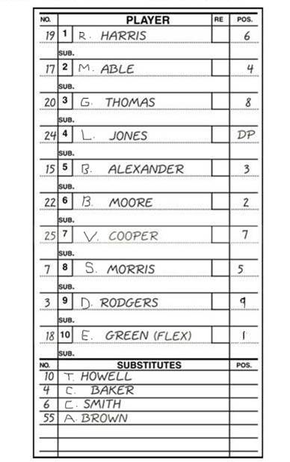

Slide 3
Remember…
- DP cannot be defense only.
- Flex cannot be offense only.
- Flex and DP cannot be on offense at same time.
- Flex and DP can play defense at same time.
- DP and Flex have one re-entry.
- Once game has started, DP/Flex positions are available for entire game.

Slide 4
Some DP/Flex changes…
“18 for 20 Mr./Ms. Umpire”
“OK blue, Flex is batting for my DP.”
“Hey blue,DP re-enters”
“10 for 24”
“55 for 10”
Flex does not play defense, meaning…?
Flex goes back in to play 2nd base.
“Blue, Flex is batting for the DP”
After Flex gets a hit…“Hey blue, can my DP run for my Flex?’’

